Slide 1
R.T.T.M. Real Time Topographical Mapping
THE COUNCIL OF ELROND:
N. SCHRAM, R. HEIFFERON, R. BUTLER

Slide 2
Topology of R.T.T.M.
EMBEDDED SYSTEM (RTOS)
ANTENNA TRANSMISSION & RECEPTION
DATA COLLECTION AND 3D MAPPING (MATLAB)
REAL TIME DISPLAY VIA PROJECTION ONTO STATIC FIELD BEING USED AS LOCATION
DATA ANALYTICS AND DISPLAY OF IDENTIFIED “HOT SPOTS” (BOTH IN 3D SOFTWARE AND IN REAL TIME PROJECTION)
“DATA DUMP” FOR POSTS PROCESSING REQUIREMENTS

Slide 3
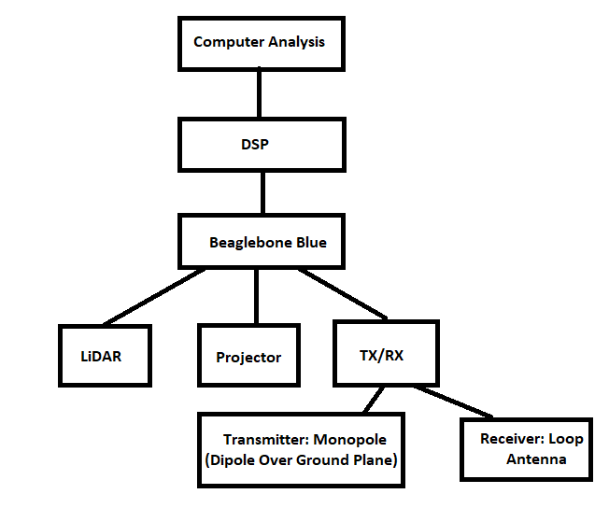
R.T.T.M. Functional Block Diagram

Slide 4
Initial
Prototyping
Setup (Proof of Concept/
Feasability)
Antenna Design & Implementation
Implement and test RF waves with respective medium
-I.E. medium with minimal conductive/magnetic properties
Identify types of transmitting and receiving antennas
-I.E. Desired wavelength and bandwidth requirements
Calculations of phase shifts for object identification
-I.E. Different materials have different reflective properties

Slide 5
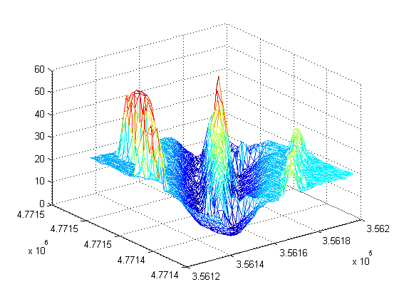
Initial Prototyping Setup (Proof of Concept/Feasability))
LiDAR/Point Cloud
Implement and test LiDAR point cloud generation
-I.E. Points per second and refresh rate
MATLAB Point Cloud Generation
-I.E. Obviously MATLAB can do this but
we’ve never done it
Engineer LiDAR mount for Topographical analysis
-I.E. LiDAR must sweep area to generate
the appropriate point cloud
Not Exact Representation

Slide 6
Purposed Sensors & Hardware
LIDAR (LIGHT DETECTION & RANGING)
CUSTOM ANTENNA (BOTH TX & RX)
MICRO/MINI PROJECTOR (POTENTIALLY XBOX KINECT FOR ADDITIONAL DETECTION)
LINUX RTOS MICROCOMPUTER (RPI, BB BLACK, BB BLUE, SNAPDRAGON, TEGRA K1)
3D MAPPING VIA MATLAB THROUGH DATA STREAM

Slide 7
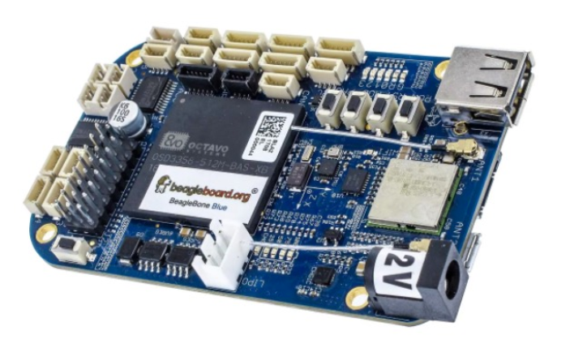
Embedded System (RTOS)
Beagle Bone Blue
TI Octavo 1GHz ARM Cortex-A8 Processor
512MB DDR3 Integrated RAM
4GB 8-bit eMMC flash storage programmed with Debain Linux
Wireless 802.11 b/g/n
Bluetooth 4.1 & BLE
(8x) 6V Servo Out control
(4x) Quadrature Encoder In
9 Axis Accelerometer & barometer
High speed USB 2.0 client & host
Interfaces: GPS, DSM2 radio, UARTs, SPI, I2C, 1.8V Analog & 3.3V GPIOs

Slide 8
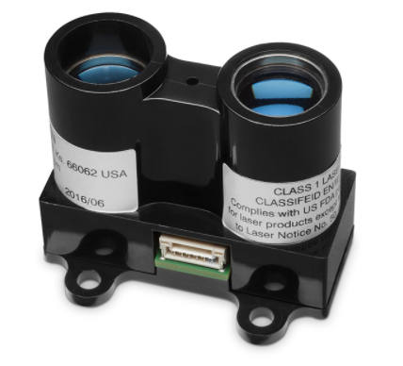
Embedded System (RTOS) Continued
Garmin Lidar Lite V3
Accuracy +/- 2.5 cm
Range: 0-40m
Power: 4.75-5 VDC, 6V Max
Current Consumption: 105 mA (idle), 130 mA (continuous)
Rep rate: 1-500Hz
Interface: I2C or PWM
Laser wave length: 905 nm
Peak Power: 1.3 watts
Beam Divergence: 8m radian
Optical aperture: 12.5mm
***Laser/Pin diode 14mm optics (Class 1 laser product)

Slide 9
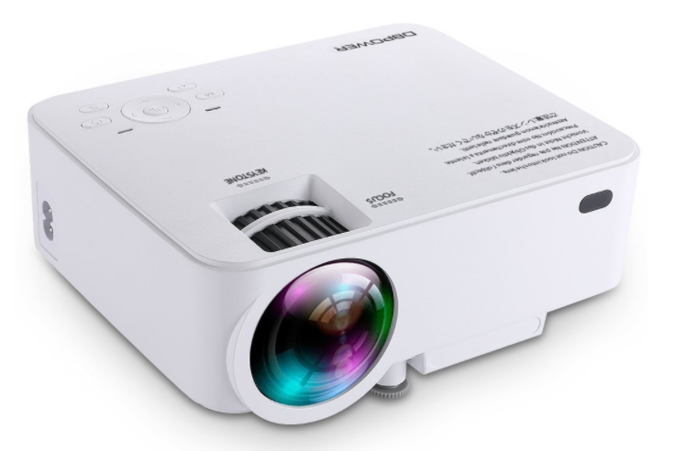
Embedded System (RTOS) Continued
DB Power Mini Projector
1500 Lumens TFT LCD
1080P
HDMI/USB/SD/VGA/AV
Contrasts: 1000:1
Aspect Ratio: 16:10
Projection Ratio: 1.4:1
Native Resolution: 800x480 pixels
Supported Resolution: 1920x1080 pixels
Screen size: 32-176”

Slide 10
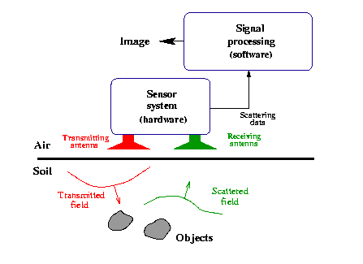
Antenna Design & Development
Ground-penetrating radar: microwave length signal
Tentative broadband transmitting antenna and possibly multiple receiving
Qualitatively design for phase-shifts with respect to limited range of materials
Image provided by:
http://www.ems.elektro.dtu.dk/research/research_projects/projects/gp

Slide 11
Budgetary Constraints & Cost Analysis
Initial investment: $300
Crowd sourcing/fund raising with local businesses for additional investments
Petition department of Electrical Engineering at CU Denver for an extended budget
Due to the nature of the hardware selected, the most critical aspect of the entire project is related to cost of the various sensors. Primarily the Lidar and Antenna.

Slide 12
Estimated Cost Breakdown
Embedded System
Antenna Design
Nuts & Bolts
Off the shelf development platform (BBB, BBBlue, RPi, Snapdragon, Tegra K1): ~$85-500
Off the shelf mini/micro projector: ~$100-250
Lidar Sensor (Garmin V3-Lite)(For prototype/feasabilty only): ~$150-200
Lidar Sensor (Final implementation, will need to be loaned or donated): ~$500-10k
Transmitting Antenna:
Receiving Antenna (loop antenna):
Waveguide/Coax connections (if required):
PCB Design & Development (if required):
Signal Processing (if required):
Physical construction of testbed (sandbox, Plexiglas): ~$35
Physical construction of testbed frame and mounting hardware (3D printed): ~$FREE
White sand: ~$5
Connections/Cabling: ~$25
Assorted Coins: ~$1

Slide 13
Next Steps
Refine the block diagram to include all aspects of design
Research on available hardware and hardware alternatives not mentioned for a complete list of what could be used for certain functions as an effort to reduce costs
Detailed budget of each ideal component and a list of alternatives for a cost analysis at the module level
Fundraising
Mathematic feasibility of the transmitting and receiving antenna for the prototyped setup and the final implemented setup
Latency investigation relating to the RTOS/Embedded System based on the speed at which we need to collect and display data for the “real time” display requirement

